Slide 1
Visual Analytics: Information Visualization 101
Ab Mosca (they/them)

Slide 2
Today’s plan
What is information visualization
Marks and channels
Rules of thumb
Examples

Slide 3
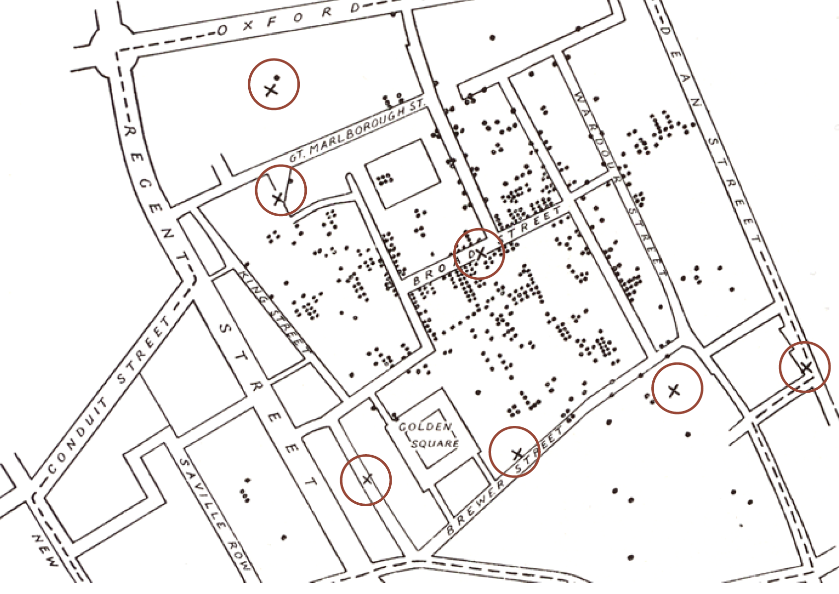
What is information visualization?
Something that reveals a trend?
More info here: http://en.wikipedia.org/wiki/1854_Broad_Street_cholera_outbreak

Slide 4
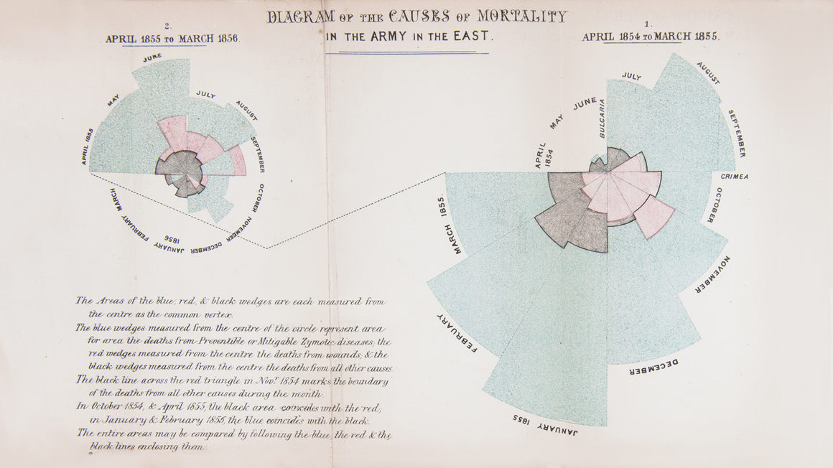
What is information visualization?
Something that influences decision making?
https://www.maharam.com/stories/sherlock_florence-nightingales-rose-diagram

Slide 5
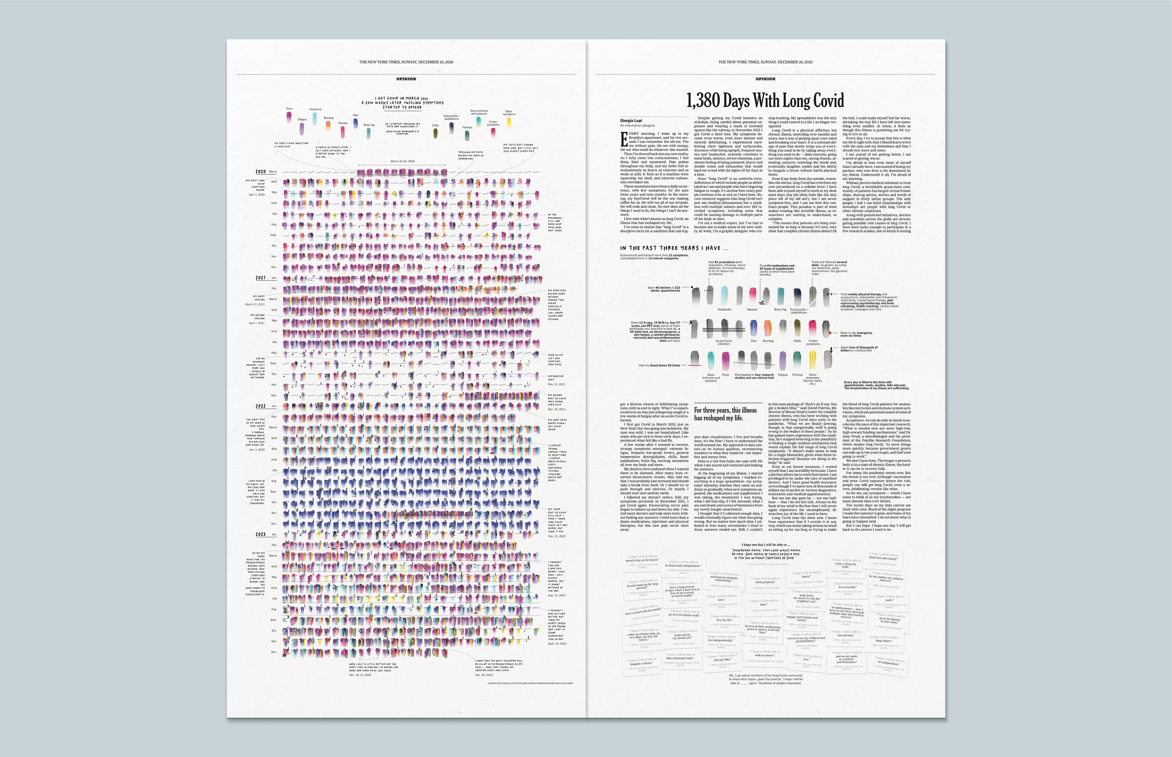
What is information visualization?
Something that tells a story?
https://giorgialupi.com/1374-days-nyt-visual-oped

Slide 6
What is information visualization?
Visual representations of data that reinforce human cognition

Slide 7
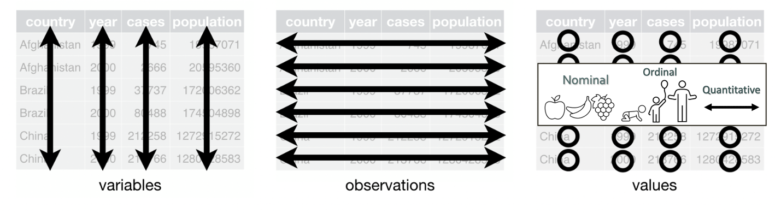
What is information visualization?
Visual representations of data that reinforce human cognition

Slide 8
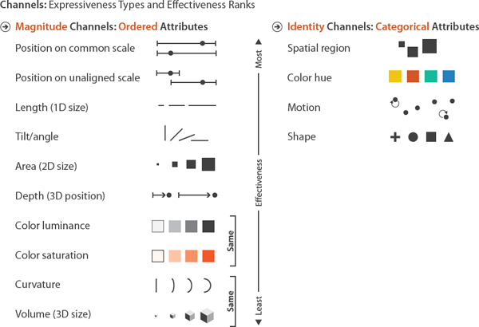
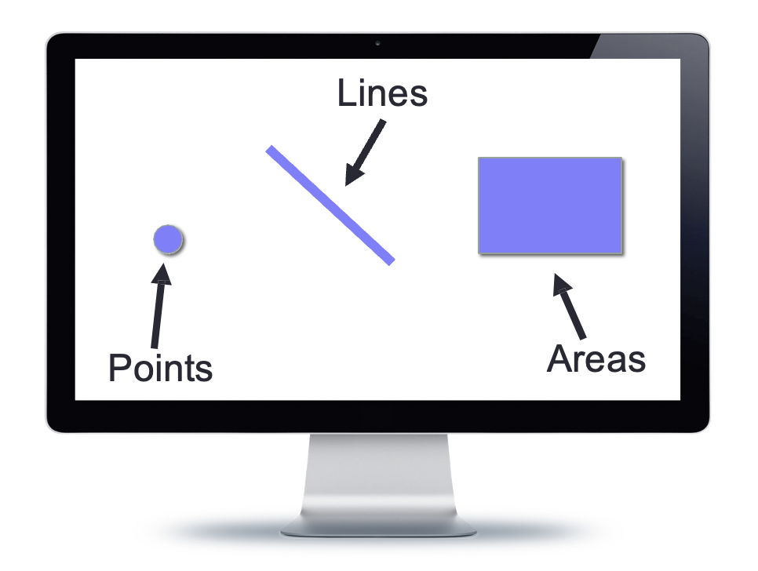
What is information visualization?
Visual representations of data that reinforce human cognition
Composed of:
Marks – the “ink”
Visual Channels – how the marks show up on the page

Slide 9
What is information visualization?
Visual representations of data that reinforce human cognition
Typically, one mark represents one observation in the dataset
For each observation, the values of the variables describing that observation are encoded via visual channels

Slide 10
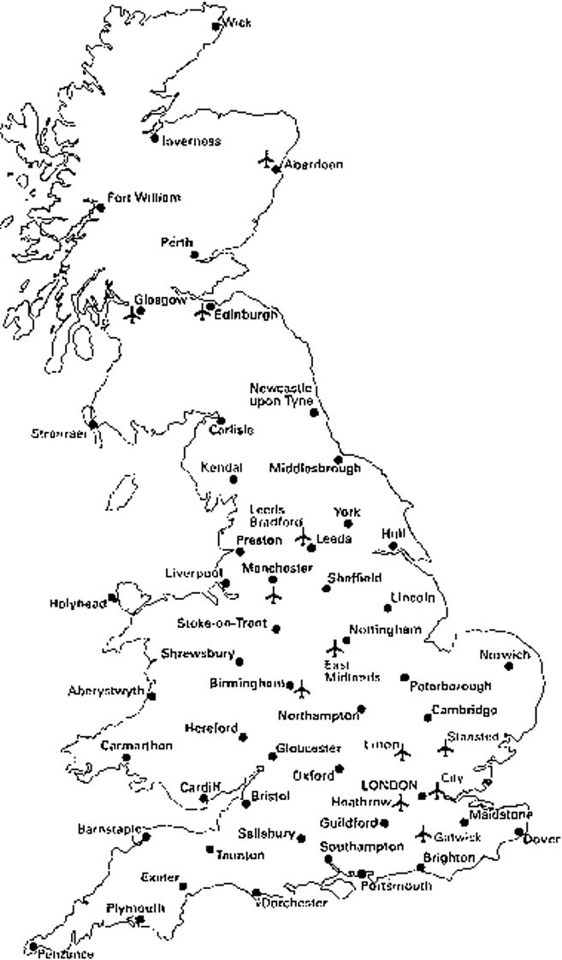
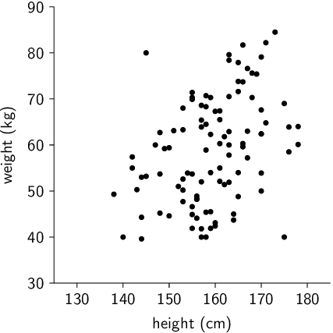
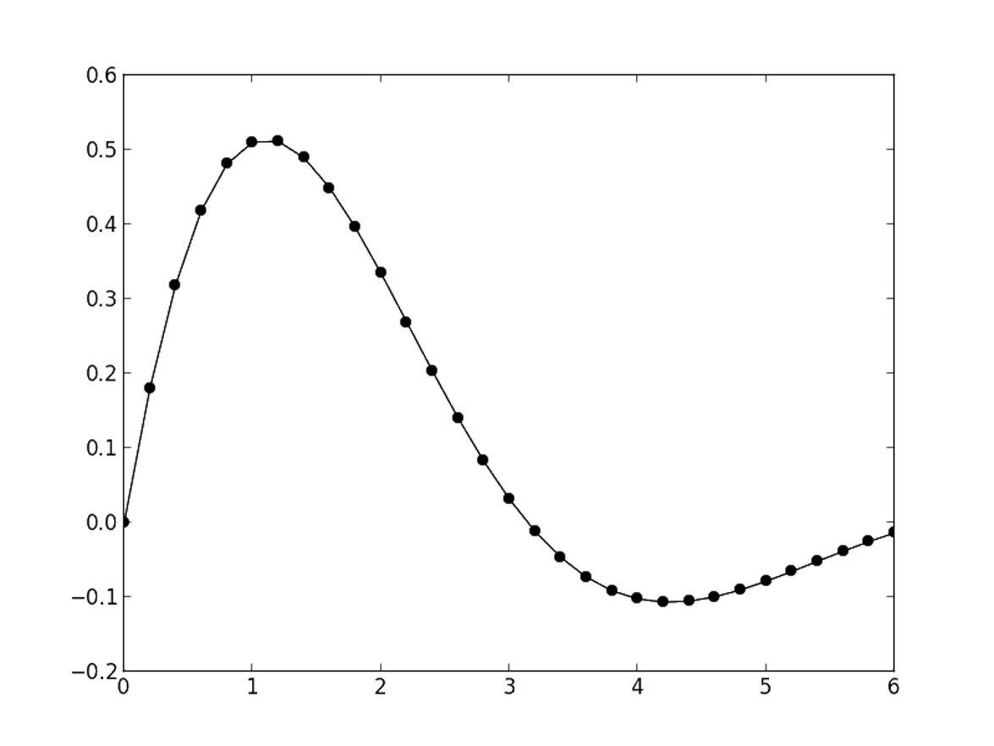
What is information visualization?
Visual Channels
Position / spatial region of a mark encodes value using where the mark is drawn

Slide 11
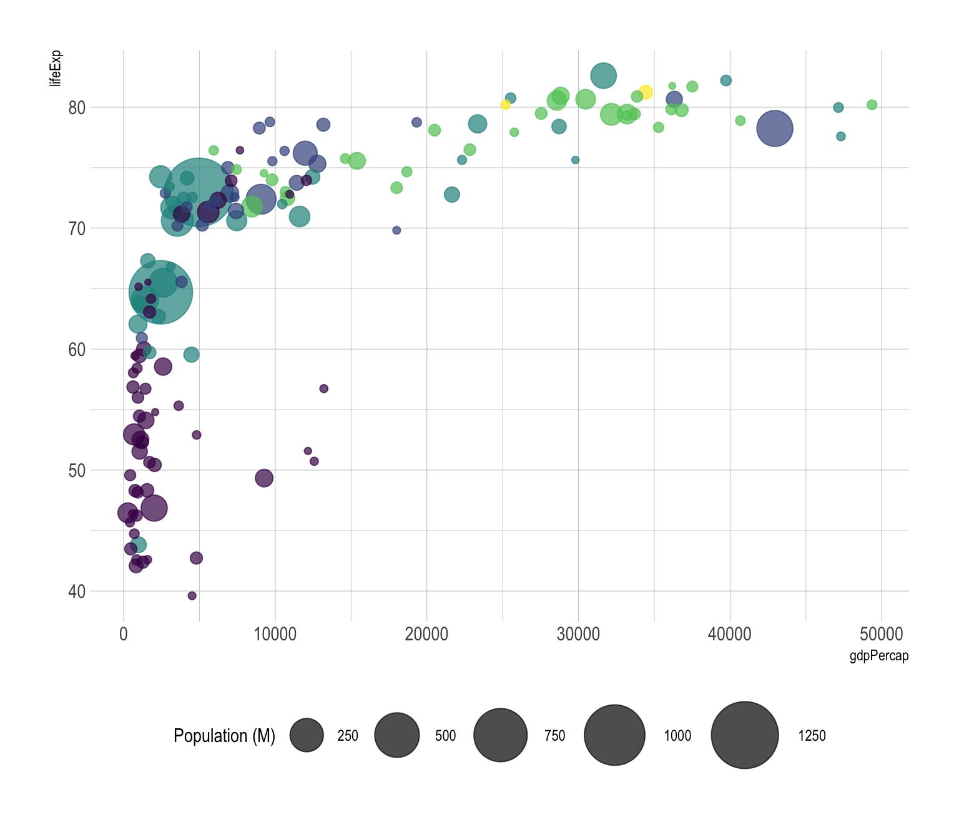
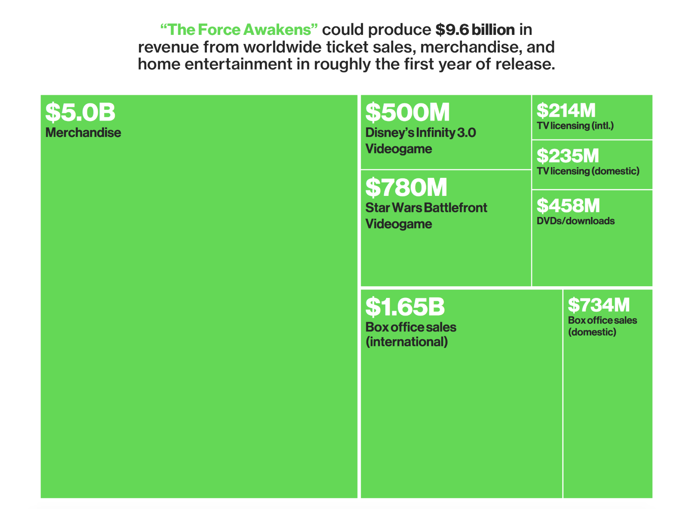
What is information visualization?
Visual Channels
Size of a mark encodes value using how big the mark is drawn
https://www.data-to-viz.com/graph/bubble.html
https://www.bloomberg.com/graphics/2015-star-wars-force-awakens-revenue/

Slide 12
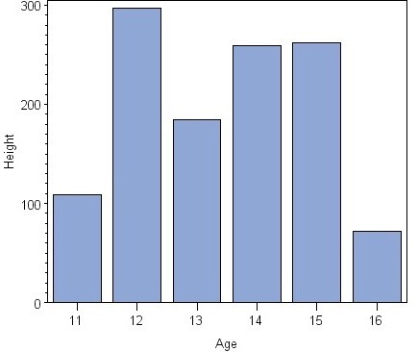
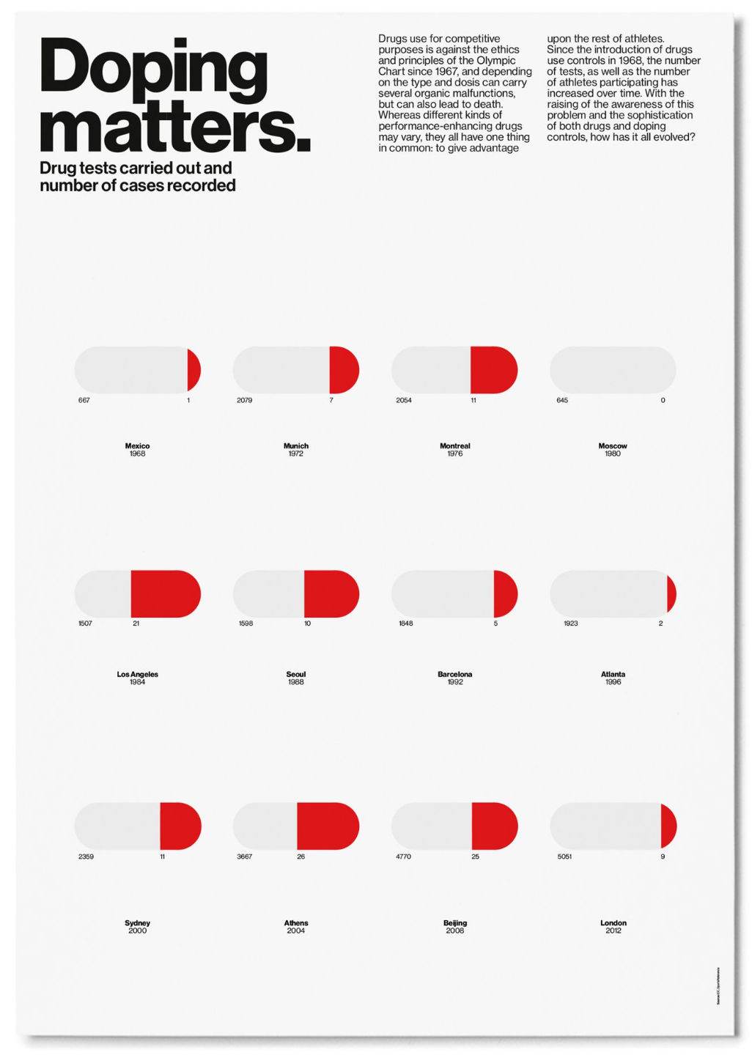
What is information visualization?
Visual Channels
Length of a mark encodes value using how long the mark is drawn

Slide 13
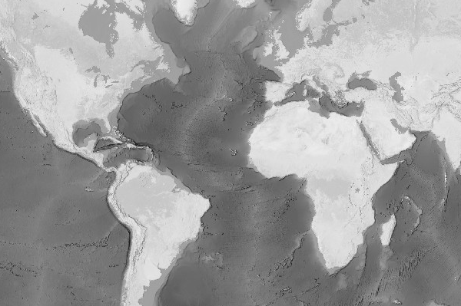
What is information visualization?
Visual Channels
Luminance of a mark encodes value using how dark the mark is drawn

Slide 14
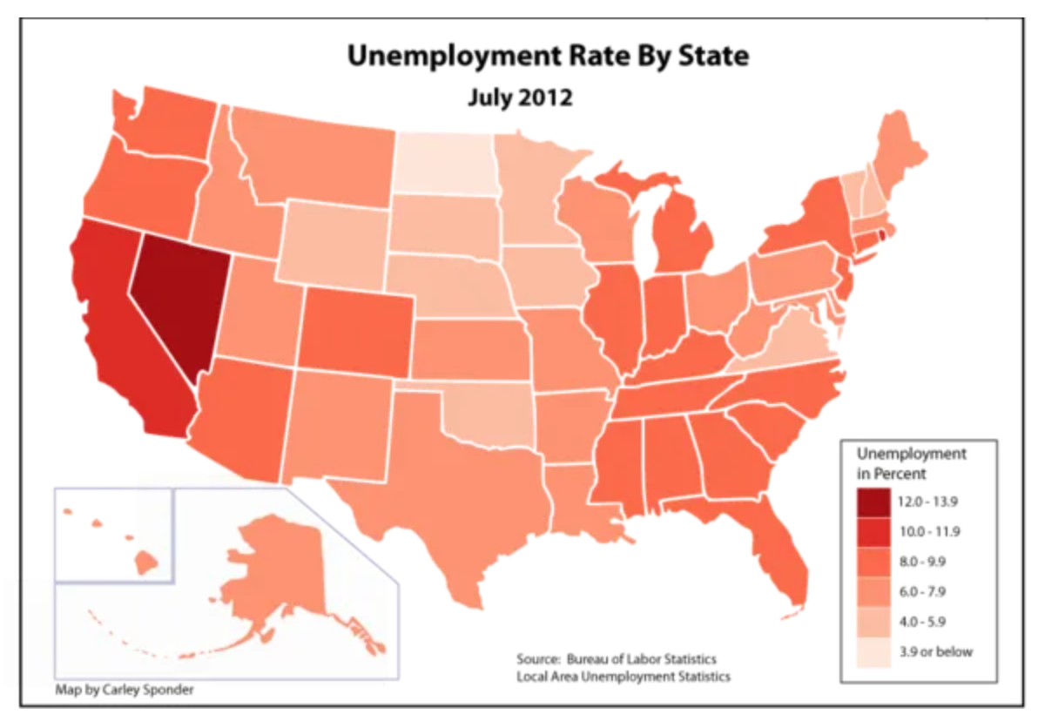
What is information visualization?
Visual Channels
Saturation of a mark encodes value using how much color the mark is drawn with

Slide 15
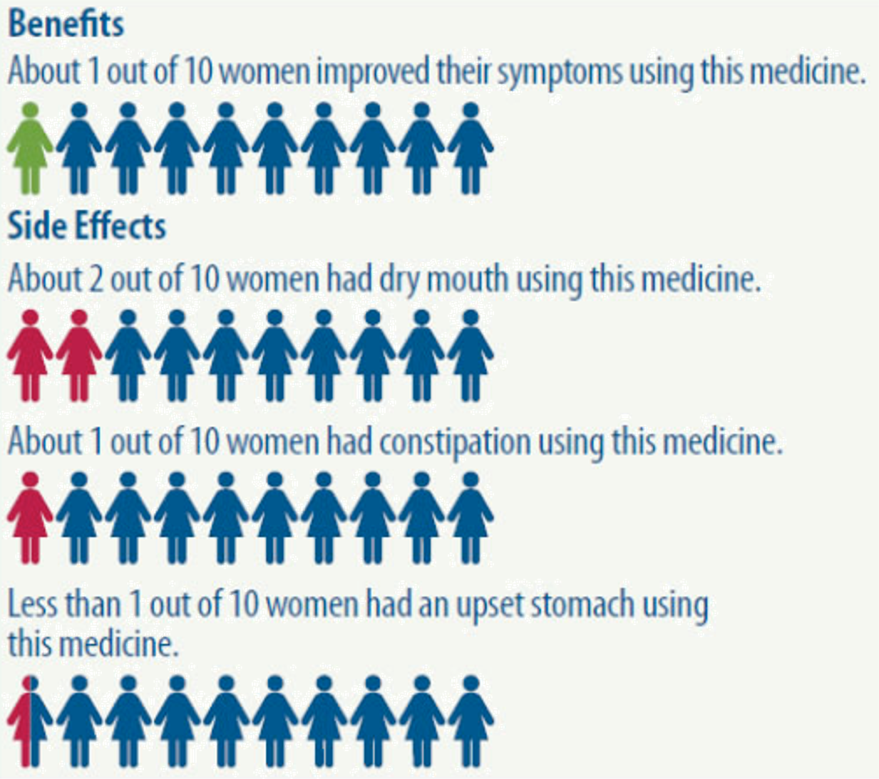
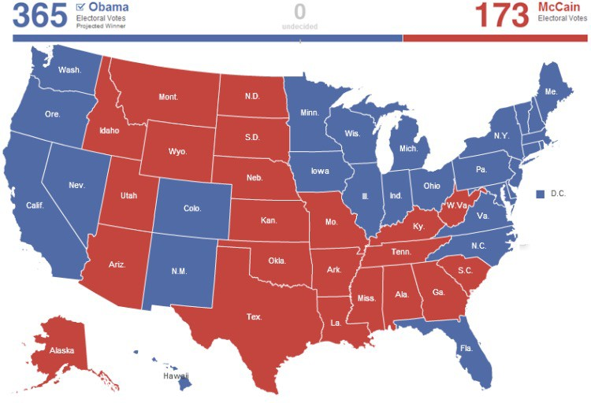
What is information visualization?
Visual Channels
Hue of a mark encodes value using hue of the mark

Slide 16
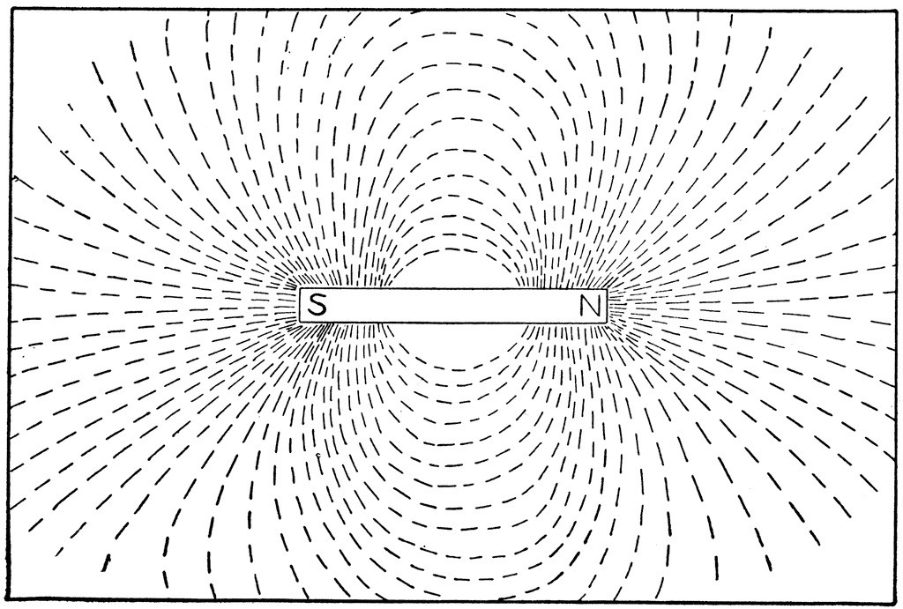
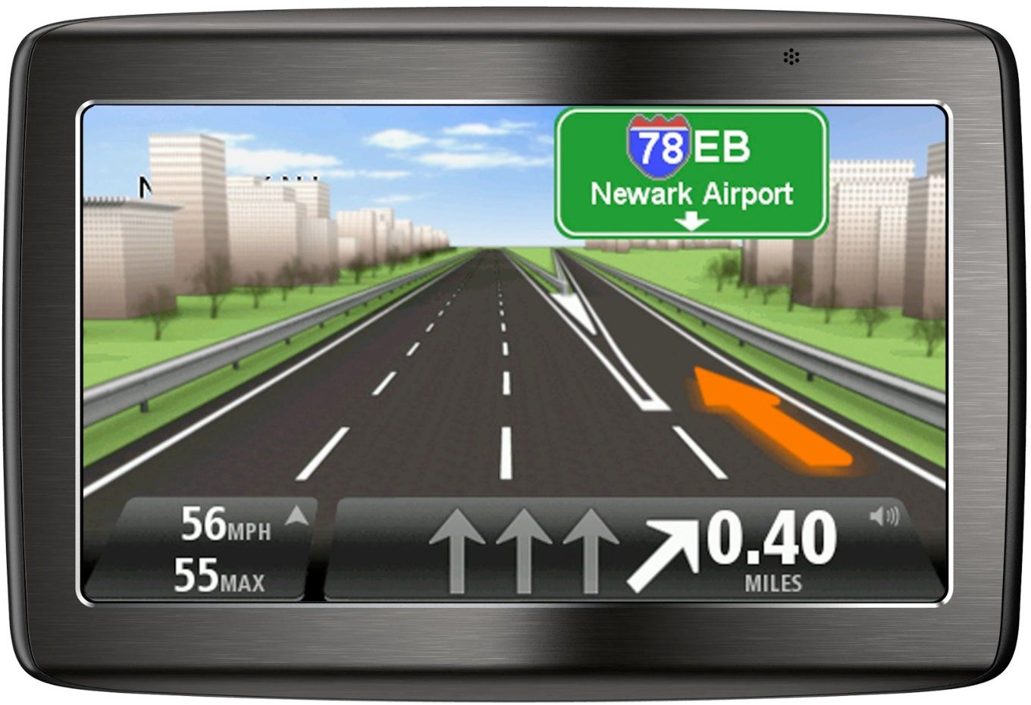
What is information visualization?
Visual Channels
Orientation / tile / angle of a mark encodes value using how the mark is rotated

Slide 17



What is information visualization?
Visual Channels
Shape of a mark encodes value using how the mark is shaped

Slide 18
What is information visualization?
Appropriateness of Visual Channels

Slide 19
Practice
Find a visualization from your favorite news source
Identify marks, channels, and what data each channel encodes

